Slide 1
Data Quality, Cleaning, and Trustworthy Variables
Chapter 3
Built from current L3 conceptual cleaning slides 2-12

Slide 2
Exploratory Data Analysis
Think of this as “listening to the data.”
Gain a big-picture understanding of what the data is telling us.
Do this before asking targeted questions of the data.

Slide 3
Variable types
A variable is any attribute which may change its value between observations in a data set.
Numeric variables: takes numbers as values
Continuous: Can take any value between its minimum and maximum.
ex: age, temperature
Discrete: Cannot take any value between its min and max; usually integers.
ex: number of ice cream flavors, number of Army and Air National Guard officers
Ordinal variables: Takes ordered categories as its values
ex: Enlisted ranks
Categorical variables: Takes unordered categories as its values
ex: Service branch, property view (“ocean”, “mountain”, etc.)

Slide 4
Why data cleaning?
Data can be messy/dirty. Why?
Data entry errors
Non-standardization
Notes:
Additional Reasons we need to clean data
Missing or Incomplete Data
Inconsistency with survey responses
Inconsistent Units or Scales – height in inches vs cm
Duplicates
Impossible values
Incorrect data types – numbers stored as strings, categories as integers, dates as text

Slide 5
Data Cleaning
Categorical variables may be recorded in an incorrect variable type in the dataset.
Example: Survey Responses
What is the “difference” between services?
Later: We will examine ways to encode categorical data numerically (binary, one-hot encoding, etc.)
Service Branch | Response
Army | 1
Marine Corps | 2
Navy | 3
Air Force | 4
Space Force | 5
Coast Guard | 6

Slide 6
Data Cleaning 101
Identifying and handling missing values
Fixing data types
Renaming and standardizing columns
Subsetting rows and columns
Detecting outliers
Basic sanity checks

Slide 7
Identifying and handling missing values
Detect missingness / count missing values
Distinguish true zeros from missing zeros
Weight = 0 $→$This is not a true zero, but a placeholder for missing data
Siblings = 0 $→$Valid entry
Dropping vs. Imputing data
Dropping rows is simple, but can remove a lot of data
Justifications

Slide 8
Identifying and handling missing values
Imputation: replacing missing values with reasonable substitutes so we don’t lose entire rows of data.
Ensure summaries and models can run
Dataset remains as representative as possible
Simple (Univariate) Imputation
Mean, Median, Mode, or replace with a constant
Intuitive but can distort distributions
Conditional (Multivariate) Imputation
Use other variables to make better guesses
Regression, k-nearest neighbors (kNN), predictive mean matching
Preserves relationships between variables, but complex and requires modeling assumptions
Multiple Imputation
Create several plausible datasets, analyze each, and combine results
Know when not to impute
Notes:
When not to impute? Ex: “Did not answer” is itself a category
When the variable isn’t needed
When missingness is too extensive
When imputation would introduce bias

Slide 9
Fixing data types
Numeric columns read as strings
Categorical variables read as integers
Dates read as text

Slide 10
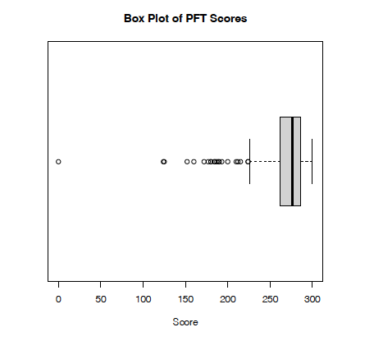
Detecting outliers
Outliers: Observations that are unusually far from the data, do not follow overall pattern
Also consider this during your visual EDA
Histograms
Boxplots
Scatterplots
Later: More techniques (e.g., leverage)
Look for these before you compute
You may be justified in cleaning (removing) outlier data
Remember: Repeatable and Defensible
Image source: EDA Example 3.5.2

Slide 11
Basic sanity checks
Prof. Alderson: “Be wary of taking data at face value, especially when you don’t know how it was generated.”
Are units consistent?
Are there impossible values?
Does the number of rows match our expectations?

Slide 12
Realities
Data-driven studies involve very large datasets
Ideally, errors fixed at the data entry point
Fix what we can
Standardize variable (column) names across datasets
Parse / remove nonsensical data
Numerical issues may be easier to spot
Summary statistics
Visual EDA
Our toy example: Errors can be an indicator of credibility of the data source
Maybe we need to find another dataset

